Slide 1

Large Scale Data Driven Applications
Overview of NoSQL Database

Slide 2
Outline
Differences between SQL and NoSQL databases
Overview of NoSQL Databases
Introduction to MongoDB
Overview of BSON and JSON Format
Basic MongoDB Model

Slide 3
Summary of early database systems
Database | Advantages | Disadvantages
Flat File Systems | Simplest form of database, storing data in plain text files. | Can leads to duplicated data and inefficient retrieval. Difficult to implement security controls to protect confidential data.
Hierarchical Database Systems | Organised data in tree-like structure with parent-child relationship. | Changes in the structure are challenging to implement. Searching in the database can be inefficient.
Network Database Systems | Modelled data using a graph structure, allowing many to many relationship. | Complexity in designing and maintaining the database schema.
Relational Database Management Systems | Organised data into tables with rows and columns. | Scalability challenges with big data with high traffic app.

Slide 4
Structure and characteristics of SQL databases
Structure: SQL databases follow a relational data model, where data is organised into tables, rows, and columns.
Schema: A rigid schema is defined in advance, specifying the data types and relationships between columns.
Normalisation: SQL databases often employ normalisation techniques to reduce data redundancy and improve data integrity.
ACID properties: SQL databases typically adhere to the ACID properties (Atomicity, Consistency, Isolation, Durability) to ensure data reliability.
Queries: Data Manipulation and Data Definition Languages to manipulate databases.
Common use cases: SQL databases are well-suited for applications that require structured data, complex queries, and transactional processing.

Slide 5
Transactions – ACID Properties
Atomic – All of the work in a transaction completes (commit) or none of it completes
a transaction to transfer funds from one account to another involves making a withdrawal operation from the first account and a deposit operation on the second. If the deposit operation failed, you don’t want the withdrawal operation to happen either.
Consistent – A transaction transforms the database from one consistent state to another consistent state. Consistency is defined in terms of constraints.
a database tracking a checking account may only allow unique check numbers to exist for each transaction
Isolated – The results of any changes made during a transaction are not visible until the transaction has committed.
a teller looking up a balance must be isolated from a concurrent transaction involving a withdrawal from the same account. Only when the withdrawal transaction commits successfully and the teller looks at the balance again will the new balance be reported.
Durable – The results of a committed transaction survive failures
A system crash or any other failure must not be allowed to lose the results of a transaction or the contents of the database. Durability is often achieved through separate transaction logs that can "re-create" all transactions from some picked point in time (like a backup).

Slide 6
SQL Database Examples
Commercial
IBM DB2
Oracle RDMS
Microsoft SQL Server
Sybase SQL Anywhere
Open Source (with commercial options)
MySQL
Ingres
Significant portions of the world’s economy use SQL databases!

Slide 7
SQL: Limitations for modern data challenges
Scalability: SQL databases can struggle to scale horizontally to handle massive datasets, often requiring expensive hardware upgrades.
Flexibility: The rigid schema of SQL databases can limit adaptability to changing data requirements, making it difficult to accommodate new data types or structures.
Performance: Complex queries and joins can become performance bottlenecks, especially when dealing with large datasets.
Unstructured data: SQL databases are not well-suited for handling unstructured data, such as text, images, and videos, which are increasingly prevalent in modern applications.
Real-time analytics: SQL databases may not be optimised for real-time analytics and data processing, which is essential for many modern applications.

Slide 8
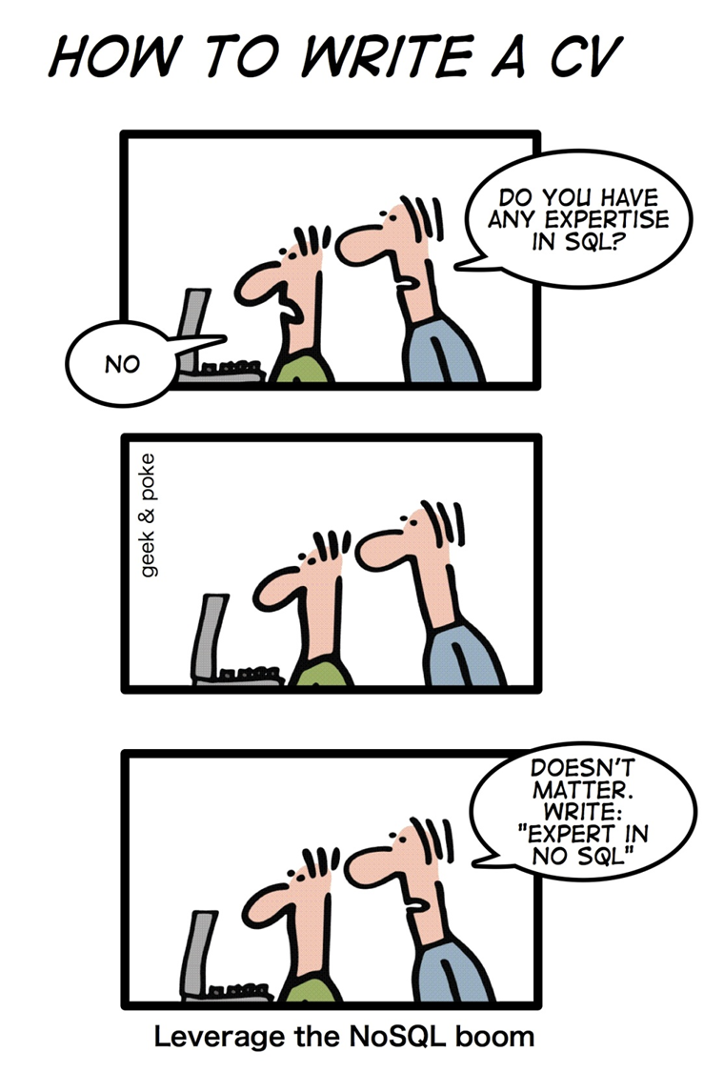
NoSQL!
NoSQL databases are currently a hot topic in some areas of computing, with over a hundred different NoSQL databases.

Slide 9
NoSQL?
NoSQL stands for:
No Relational
No RDBMS
Not Only SQL
NoSQL is an umbrella term for all databases and data stores that don’t follow the RDBMS principles
A class of products
A collection of several (related) concepts about data storage and manipulation
Often related to large data sets

Slide 10
NoSQL Distinguishing Characteristics
Large data volumes
Google’s “big data”
Scalable replication and distribution
Potentially thousands of machines
Potentially distributed around the world
Queries need to return answers quickly
Mostly query, few updates
Asynchronous Inserts & Updates
Schema-less
ACID transaction properties are not needed – BASE
CAP Theorem
Open source development
Notes:
BASE: Basically Available Soft state Eventually consistent

Slide 11
CAP Theorem
Three properties of a system
Consistency (all copies have same value)
Availability (system can run even if parts have failed)
All nodes can still accept reads and writes
Partition Tolerance (Even if part is down, others can take over)
CAP “Theorem”: You can have at most two of these three properties for any system

Slide 12
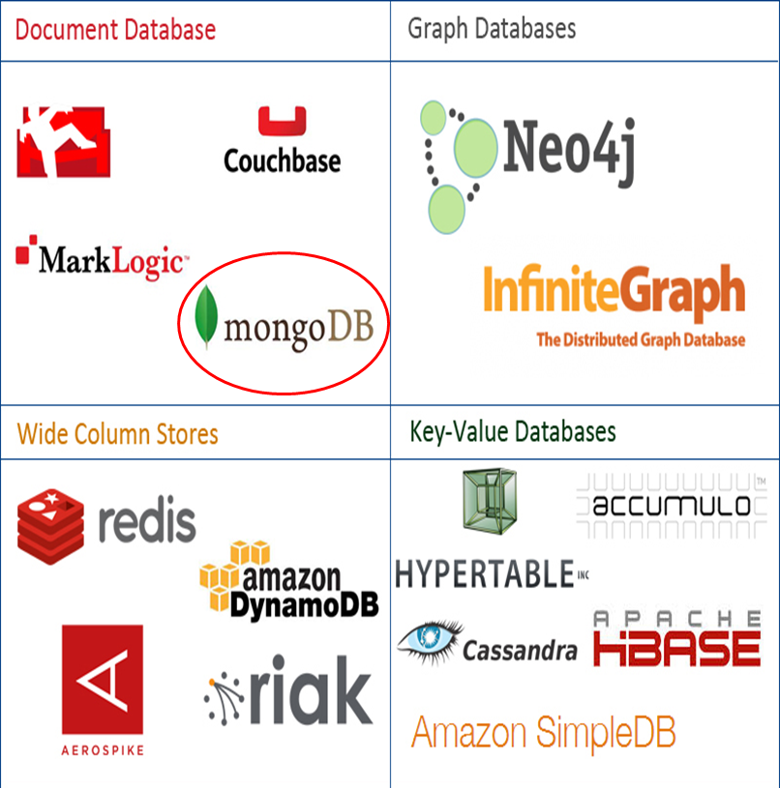
NoSQL Database Types
Data stored in 4 types:
Document Stores
Graph Databases
Key-value Stores
Wide-column Stores

Slide 13
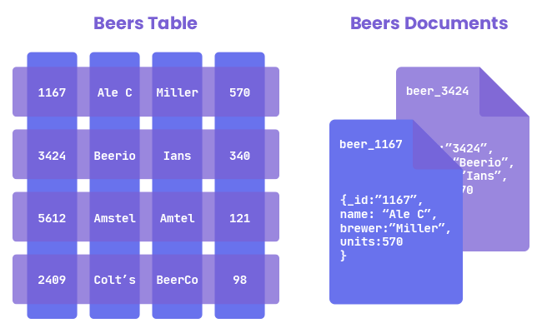
Document Stores
Documents are stored in some standard format or encoding (e.g., XML, JSON, PDF or Office Documents)
These are typically referred to as Binary Large Objects (BLOBs)
Documents are addressed in the database via a unique key that represents that document.
The database offers an API or query language that retrieves documents based on their contents.
Documents are schema free, i.e., different documents can have structures and schema that differ from one another. (An RDBMS requires that each row contain the same columns.)
E.g., MongoDB and CouchDB
Source: https://ravendb.net/articles/nosql-document-oriented-databases-detailed-overview

Slide 14
Document Databases: JSON
{
_id: ObjectId("51156a1e056d6f966f268f81"),
type: "Article",
author: "Derick Rethans",
title: "Introduction to Document Databases with MongoDB",
date: ISODate("2013-04-24T16:26:31.911Z"),
body: "This arti…"
},
{
_id: ObjectId("51156a1e056d6f966f268f82"),
type: "Book",
author: "Derick Rethans",
title: "php|architect's Guide to Date and Time Programming with PHP",
isbn: "978-0-9738621-5-7"
}

Slide 15
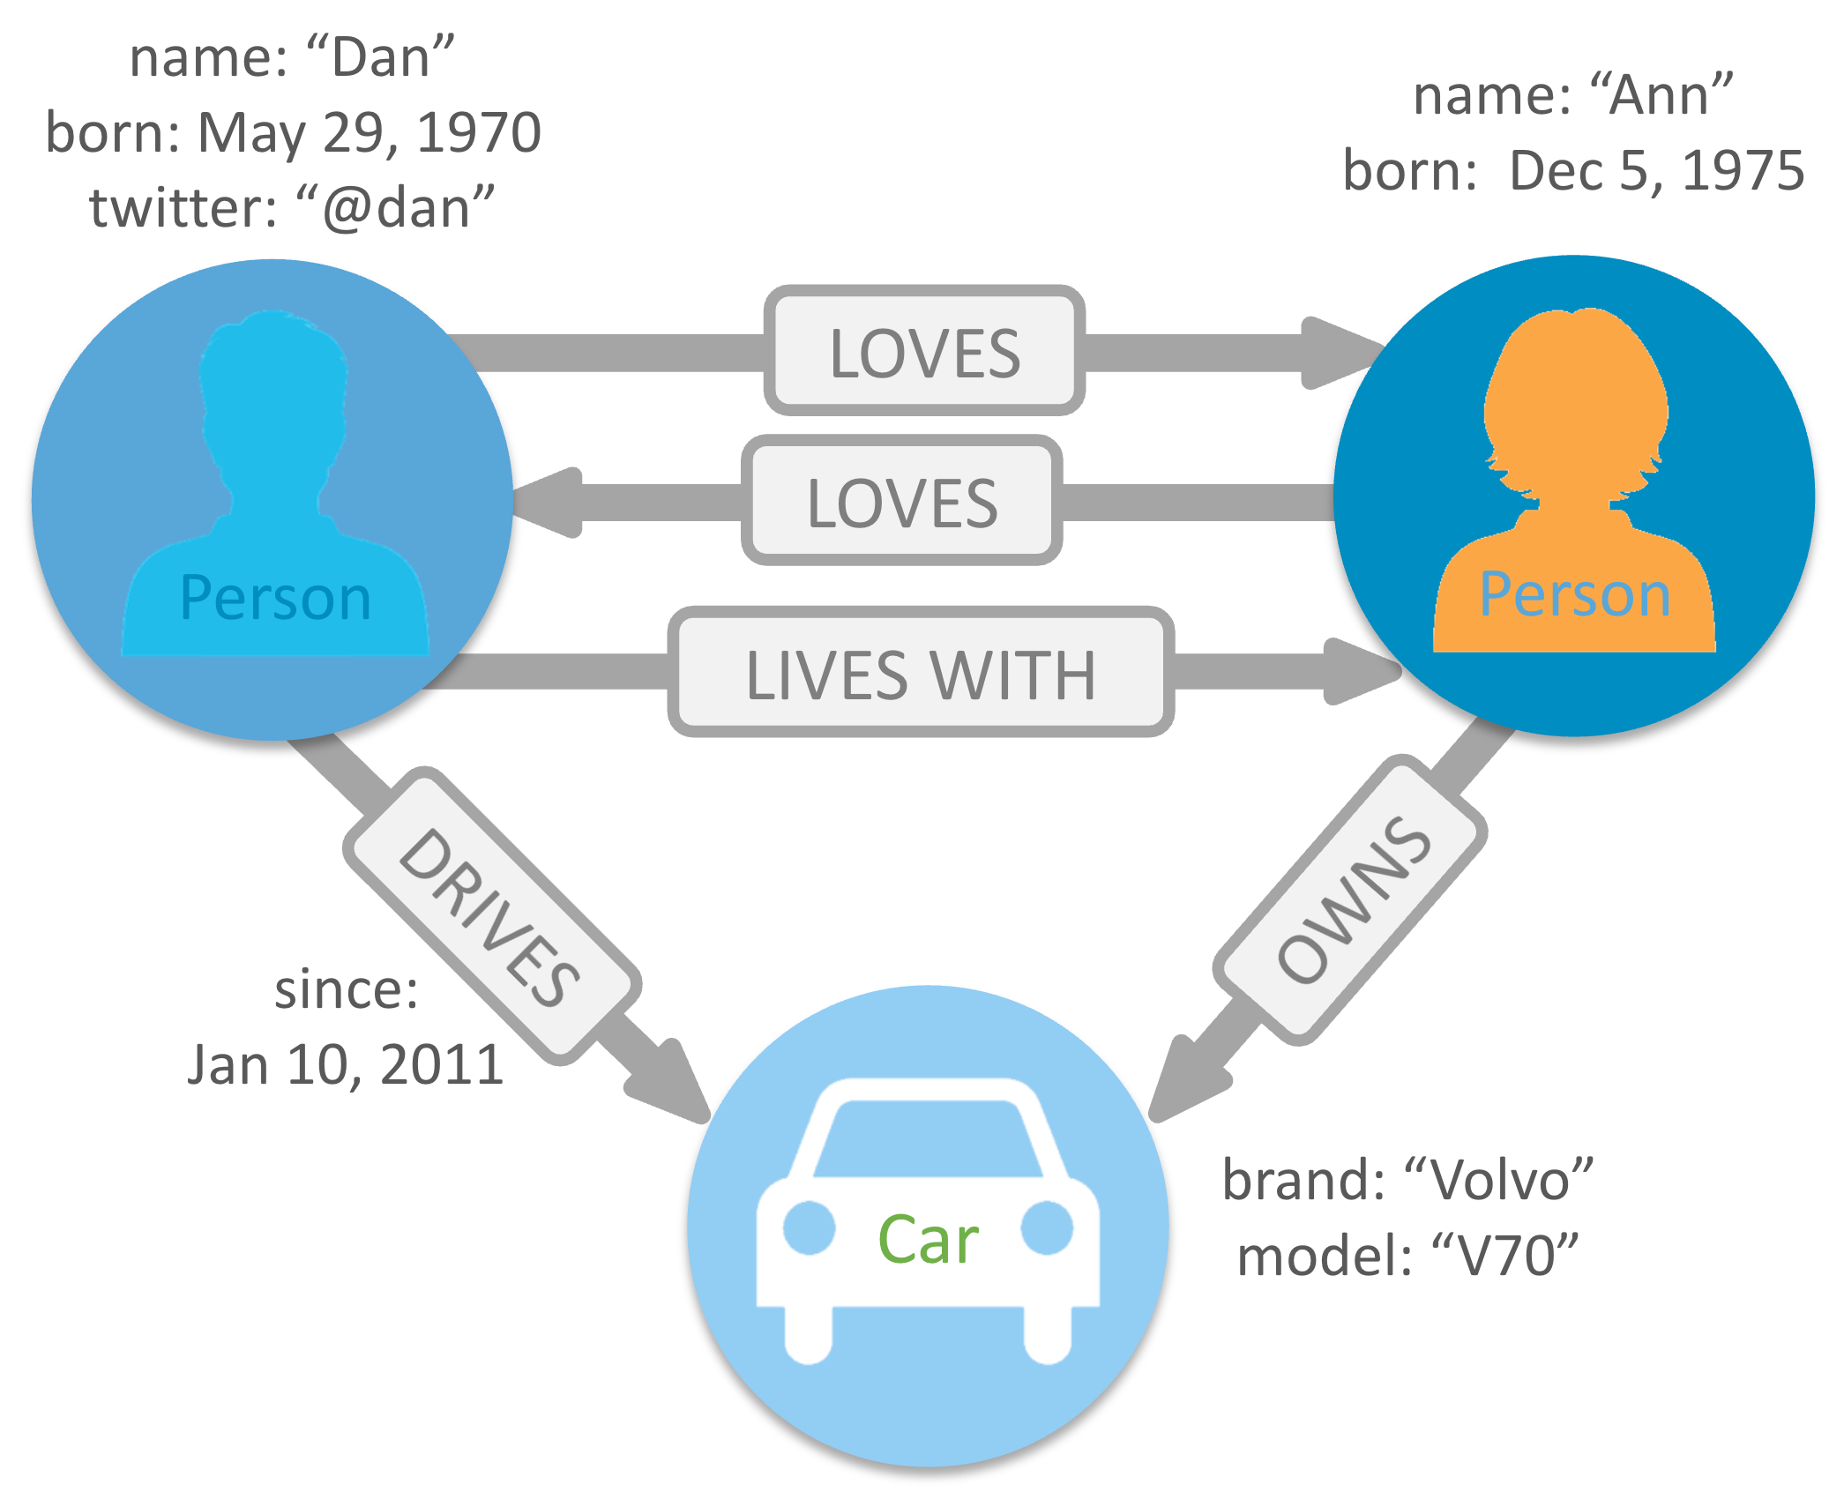
Graph Databases
Graph-oriented.
Everything is stored as a node , an edge, or an attribute.
Each node and edge can have any number of attributes.
Both the nodes and edges can be labelled.
Labels can be used to narrow searches.
Graph databases are powerful for graph-like queries (e.g., find the shortest path between two elements)
E.g., Neo4j and VertexDB
Source: https://j471n.in/blogs/graph-databases-vs-relational-databases

Slide 16
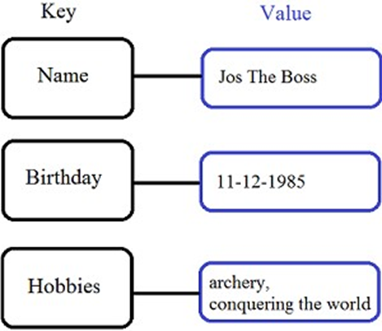
Key-Value Stores
It is a data storage designed for storing simple key-value pairs, where a key is a unique identifier, that has a value assigned to it.
Keys are mapped to (possibly) more complex value (e.g., lists)
Keys can be stored in a hash table and can be distributed easily
Such stores typically support regular CRUD (create, read, update, and delete) operations
E.g., Amazon DynamoDB and Apache Cassandra

Slide 17
Wide-column Stores
Data are stored in a column-oriented way
Avoids consuming space for storing nulls
Columns are grouped in column-families
Data isn’t stored as a single table but is stored by column families
Unit of data is a set of key/value pairs
Identified by “row-key”
Ordered and sorted based on row-key
Well-suited for read and write intensive workloads
Notable for:
Google's Bigtable (used in all Google's services)
HBase (Facebook, StumbleUpon, Hulu, Yahoo!, ...)
Row-oriented
ID | Name | Year | GPA
001 | John | Final | 3.96
002 | Alice | Second | 3.57
003 | Bob | First | 3.29
Column-oriented
Name | ID
John | 001
Alice | 002
Bob | 003
Year | ID
Final | 001
Second | 002
First | 003
GPA | ID
3.96 | 001
3.57 | 002
3.29 | 003

Slide 18
Advantages and Disadvantages of SQL vs NoSQL
Advantages of SQL:
Structured Data: Strong support for structured data, ensuring integrity.
Complex Queries: SQL excels in complex joins, transactions, and aggregations.
Widely Adopted: Most relational databases have been around for decades.
Advantages of NoSQL:
Scalability: Horizontally scalable for distributed applications.
Schema Flexibility: Can handle dynamic and changing data models.
Big Data Support: Suited for large-scale applications, unstructured data, and real-time analytics.
Disadvantages of NoSQL:
Complex Transactions: Limited support for multi-operation transactions.
Eventual Consistency: May lead to inconsistencies during data retrieval.
Disadvantages of SQL:
Scaling Issues: Difficult to scale beyond a certain limit.
Rigid Schema: Less flexibility in adapting to changes in data structure.

Slide 19

Introduction to MongoDB
What is MongoDB?
A popular, open-source NoSQL database designed to store and manage large volumes of unstructured or semi-structured data.
It uses a document-oriented data model
Data is stored in flexible, JSON-like documents called BSON (Binary JSON)

Slide 20
Key Features of MongoDB
Document-Oriented: Stores data as documents within collections, providing a flexible schema.
Schema Flexibility: No fixed schema is required, making it easy to modify the structure as your application evolves.
Scalability: Horizontal scaling through sharding, distributing data across multiple servers for high availability and load balancing.
High Availability with Replication: Ensures data redundancy and high availability through replica sets, automatically replicating data across multiple nodes for continuous operation during failures.
Indexing: Supports a variety of indexing techniques (e.g., single, compound, geospatial), allowing efficient query performance even for large datasets.
Aggregation Framework: Offers powerful tools for advanced data processing, enabling efficient complex queries, filtering, grouping, and aggregation.

Slide 21

When to Use MongoDB?
Best Use Cases:
Applications with dynamic data models (e.g., social media, IoT).
Plenty of unstructured data
High traffic, real-time applications (e.g., messaging apps, e-commerce).
You change your schema very often on a large dataset
Data analytics and Big Data projects.
When Not to Use:
Applications requiring complex, multi-table transactions.
When strong consistency is a must.

Slide 22
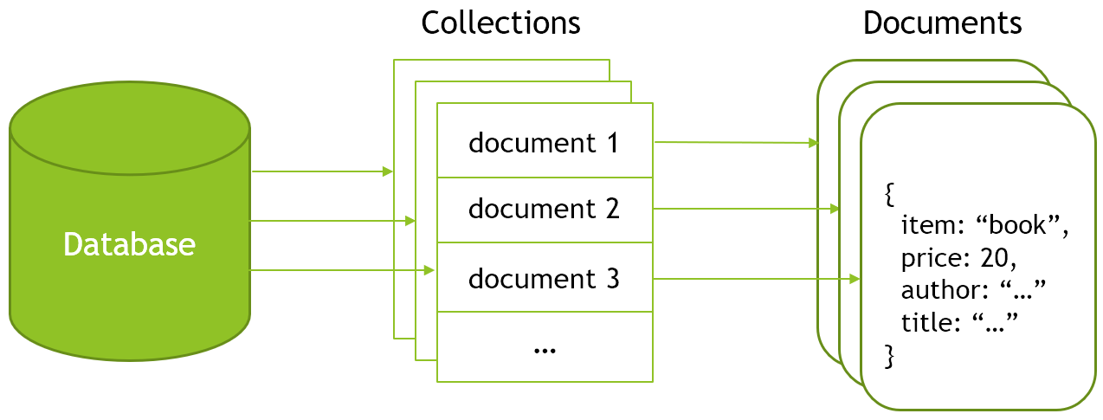
MongoDB Architecture
Databases: Can contain one or more collections
Collections: Can contain different types of document
Documents: Can contain key-value pair list (a.k.a—fields) or array or nested documents. Used JSON-like structure, stored as BSON.
Image source: https://se-education.org/learningresources/contents/data/nosql/NoSQL.html

Slide 23
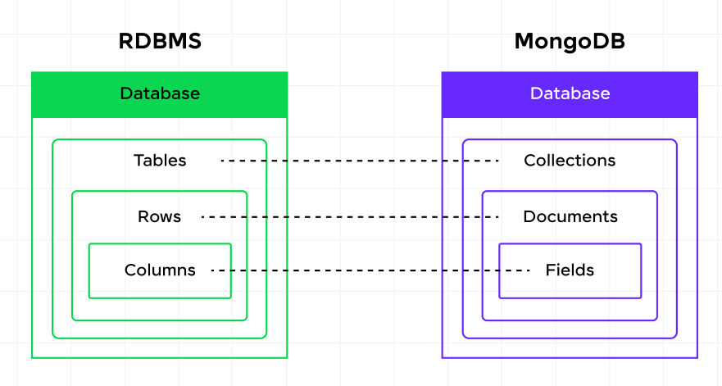
Analogy between RDBMS and MongoDB
Source: https://www.guvi.in/blog/mongodb-vs-sql-top-differences/

Slide 24
Overview of JSON and BSON Formats
What is JSON?
Lightweight, human-readable text-based format
Data is in name/value pairs
A name/value pair consists of a field name followed by a colon, followed by a value:
Example: "name": "John"
Data is separated by commas
Example: "name": "John", "age": 30
Curly braces hold objects
Example: { "name": "John", "age": 30 }
An array is stored in brackets [ ]
Example: [{ "name": "John", "age": 30 }, { "name": "Peter"}]

Slide 25
Overview of JSON and BSON Formats
What is BSON?
Binary format of JSON, used by MongoDB
Not human-readable like JSON
Optimised for speed and storage efficiency
Supports additional data types like dates, arrays, and objects
Why MongoDB Uses BSON?
Faster encoding/decoding
Efficient storage for large-scale data

Slide 26
Overview of BSON and JSON Formats: Example
{"hello": "world"} →
\x16\x00\x00\x00 // total document size
\x02 // 0x02 = type String
hello\x00 // field name
\x06\x00\x00\x00world\x00 // field value
\x00 // 0x00 = type EOO ('end of object')
{"BSON": ["awesome", 5.05, 1986]} →
\x31\x00\x00\x00
\x04BSON\x00
\x26\x00\x00\x00
\x02\x30\x00\x08\x00\x00\x00awesome\x00
\x01\x31\x00\x33\x33\x33\x33\x33\x33\x14\x40
\x10\x32\x00\xc2\x07\x00\x00
\x00
\x00

Slide 27
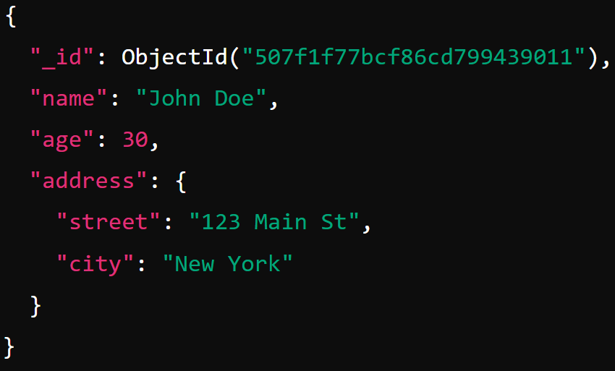
MongoDB document
_id is a special field in each document
Unique within each collection
_id → Primary Key in RDBMS
The field names cannot start with the $ character
reserved for operators
The field names cannot contain the . Character
Reserved for accessing fields
Have maximum size: 16MB (in BSON)
Notes:
An ObjectId is a 12-byte BSON type having the following structure −
The first 4 bytes representing the seconds since the Unix epoch
The next 3 bytes are the machine identifier
The next 2 bytes consists of process id
The last 3 bytes are a random counter value

Slide 28
Data Types of MongoDB
String : This is most commonly used datatype to store the data. String in mongodb must be UTF-8 valid.
Integer : This type is used to store a numerical value. Integer can be 32 bit or 64 bit depending upon your server.
Boolean : This type is used to store a Boolean (true/ false) value.
Double : This type is used to store floating point values.
Min/ Max keys : This type is used to compare a value against the lowest and highest BSON elements.
Arrays : This type is used to store arrays or list or multiple values into one key.
Timestamp : ctimestamp. This can be handy for recording when a document has been modified or added.
Object : This datatype is used for embedded documents.
Integer
Boolean
Double
String
Arrays
Null
Object ID
Binary data
Date
commonly used datatype

Slide 29
Data Types of MongoDB
Null: This type is used to store a Null value.
Symbol: This datatype is used identically to a string however, it's generally reserved for languages that use a specific symbol type.
Date: This datatype is used to store the current date or time in UNIX time format. You can specify your own date time by creating object of Date and passing day, month, year into it.
Object ID: This datatype is used to store the document’s ID.
Binary data: This datatype is used to store binary data.
Code: This datatype is used to store JavaScript code into document.
Regular expression: This data type is used to store regular expression
Integer
Boolean
Double
String
Arrays
Null
Object ID
Binary data
Date
commonly used datatype

Slide 30
Traditional SQL Database vs MongoDB Example
Users table in a relational database
ID | first_name | last_name | mobile | city
1 | John | Doe | 01456123789 | Bradford
MongoDB collection Users
Query to Find Users in Bradford
{
"ID": 1,
"first_name": "John",
"last_name": "Doe",
"mobile": "01456123789",
"city": "Bradford"
}
SQL version:
SELECT *
FROM Users
WHERE city = 'Bradford';
MongoDB version:
db.Users.find({ "city": "Bradford" });
Notes:
In this MongoDB query, we are using the find() function to retrieve all documents from the Users collection where the city field is equal to "Bradford".

Slide 31
Traditional SQL Database vs MongoDB Example
Users table in a relational database
ID | first_name | last_name | mobile | houseNo | street | city
1 | John | Doe | 01456123789 | 15 | Richmond | Bradford
MongoDB Collection with Separate Fields
MongoDB Collection with Address Field Nested
{
"ID": 1,
"first_name": "John",
"last_name": "Doe",
"mobile": "01456123789",
"address": {
"houseNo": 15,
"street": "Richmond",
"city": "Bradford"
}
}
{
"ID": 1,
"first_name": "John",
"last_name": "Doe",
"mobile": "01456123789",
"houseNo": 15,
"street": "Richmond",
"city": "Bradford"
}
Query for Nested Version to find Users in Bradford
db.Users.find({ "address.city": "Bradford" });

Slide 32
Traditional SQL Database vs MongoDB Example
Users table
ID | first_name | last_name | mobile | city
1 | John | Doe | 01456123789 | Bradford
2 | Alisha | Khan | 01673986745 | London
Hobbies table
{
"ID": 2,
"first_name": "Alisha",
"last_name": "Khan",
"mobile": "01673986745",
"city": "London",
"hobbies": ["Cycling", "Photography"]
}
ID | user_id | hobby
10 | 1 | Reading
11 | 2 | Cycling
12 | 2 | Photography
13 | 1 | Gaming

Slide 33
Questions?

Slide 34
Some content in this presentation was inspired by and/or adapted from:
Dr. Sampath Jayarathna’s lecture on “Introduction to Data Science & Analytics”
Mohammad Hammoud’s lecture on “Database Applications ”

